Slide 1
Transmission Coefficients and Residual Energies of Electrons: PENELOPE Results and Empirical Formulas
Third International Workshop on Electron and
Photon Transport Theory Applied to Radiation Dose Calculation
Hyatt Regency Hotel, Indianapolis, Indiana
August 8-12, 1999
Tatsuo Tabata and Vadim Moskvin*
Osaka Prefecture University and IDEA
*Indiana University School of Medicine
Notes:
Good afternoon, a lady and gentlemen!
I’ll talk about transmission coefficient of electrons and residual energy of transmitted electrons, both studied by the use of PENELOPE Monte Carlo code.
This work has been done together with Vadim Moskvin now working under Lech Papiez at Indiana University.
I have retired from Osaka Prefecture University, and am now working at IDEA, Institute for Data Evaluation and Analysis, located at my home.

Slide 2
Abstract
We have generated the data on
  the number transmission coefficient η_{TN} of electrons
  residual energy T_{r} of transmitted electrons
by the PENELOPE Monte Carlo code, and have compared them with those in the literature.
The primary electrons were assumed to be incident
  with energies 0.1–50 MeV
  on absorbers of atomic numbers 4-92
  at different angles.
Improvement of empirical formulas given previously for these parameters is in progress by using the data obtained.
  A general formula for η_{TN} is given.
Notes:
This viewgraph shows the outline of my talk.
Using the PENELOPE code, we have generated data on two parameters important in using electron beams,
the number transmission coefficient etaTN,
and the residual energy Tr of transmitted electrons.
The primary electrons were assumed to be incident
with energies from 0.1 to 50 MeV
on absorbers of atomic numbers from 4 to 92
at different angles.
Improvements of empirical formulas given previously for these parameters are in progress by using the data obtained.
A tentative result of a general formula for etaTN is given.

Slide 3
Introduction
Definitions of the quantities treated
  Number transmission coefficient η_{TN}: the ratio of the number of electrons transmitted by a slab absorber to the number of incident electrons
  Residual energy T_{r} of transmitted electrons: the ratio of the total energy of electrons transmitted by a slab absorber to the number of transmitted electrons
Note: Knock-on electrons are included in most experimental and MC results as “transmitted electrons,” but not in the present work.
Notes:
One of the parameters we treat, the number transmission coefficient etaTN, is defined as
the ratio of the number of electrons transmitted by a given slab absorber
to the number of incident electrons.
The other of the parameters, the residual energy Tr of transmitted electrons, is defined as
the ratio of the total energy of electrons transmitted by a given slab absorber
to the number of transmitted electrons.
Most of experimental and Monte Carlo results published earlier include knock-on electrons in “transmitted electrons.”
However, we do not count these electrons as transmitted electrons, following the strict definitions of these parameters.

Slide 4
Introduction (continued)
Motivations
  Better empirical formulas for η_{TN} and T_{r} are necessary for improving the semiempirical depth–dose code EDMULT.
  An empirical formula for η_{TN} is useful for simple evaluation of
  “the average depth of electron penetration” (Ref. Moskvin)
  Bichsel’s comment on Berger’s talk at 2nd I WEPT lead us to a question: “How accurate can an empirical formula for η_{TN} be made?”
Notes:
We have three motivations for the present work.
First, better empirical formulas for etaTN and Tr are necessary for improving the semiempirical multilayer depth-dose code EDMULT, about which I talked at the 1st and the 2nd meetings of this workshop.
Secondly, an empirical formula for etaTN is useful for simple evaluation of “the average depth of electron penetration,” about which Vadim will talk in the final presentation of today.
Thirdly, Hans Bichsel’s comment on Martin Berger’s talk at the 2nd I WEPT, namely the previous meeting of this workshop, lead us or at least lead “me” to the question, “How accurate can an empirical formula for etaTN be made?”

Slide 5
Introduction (continued)
Related previous work
  Monte Carlo calculations of η_{TN}
    Normal incidence: Seltzer & Berger, NIM 119, 157 (1974) (ETRAN)
    Oblique incidence: Watts & Burrell, NASA TN D-6385 (1971) (for Al; ETRAN)
  Empirical formulas for η_{TN}
    Normal incidence: Tabata et al., NIM 127, 429 (1975) & papers cited there
    Oblique incidence: Tabata et al., NIM 136, 533 (1976) (for Al only)
  Monte Carlo calculation of T_{r}
    Normal incidence for light materials only
  Empirical formulas for T_{r}
    Simple linear relation for low-Z materials (normal incidence)
    Approximate expressions used in depth–dose algorithms (normal incidence)
Notes:
Previous results for etaTN and Tr have mostly been obtained in 1970s. So the presentwork is revisiting to the problems of almost 30 years ago. Berger and Seltzer obtained the results for transmission curves of electrons normally incident on different absorbers by the ETRAN Monte Carlo code in 1971, and compared them with experimental data.
Watts & Burrell obtained the results of ETRAN for different angles of incidence for Al absorbers.
Empirical formulas for the transmission coefficient etaTN have been proposed by myself and coworkers in 1975, and also by many authors listed in our paper. A formula to express the dependence on angle of incidence was given by myself and coworkers in 1976, but it was applicable only for Al absorbers.
Monte Carlo calculations for the residual energy Tr have been made only for light materials important in medical physics and for normal incidence.
Empirical formulas for Tr are available as a simple linear relation for low atomic number materials or as approximate expressions used in the depth–dose algorithm, and all of them are applicable only to normal incidence.

Slide 6
Method
Generation of Data
  Monte Carlo (MC) code used PENELOPE (Ref. Fernández-Valea)
  Present treatment
    Included generation of SE and photons
    The above not traced for scoring
    Used “the method of full trajectories” (Ref. Moskvin)
  Incident energies
  0.1–50 MeV
  Absorber materials
  Be, C, Al, Cu, Ag, Au, U
  Angles of incidence
  0–80 deg at 10-deg step, 89.9 deg
Notes:
In the present work, data on the transmission coefficient and the residual energy have been generated by the use of the PENELOPE Monte Carlo code, about which Jose Maria gave us a lecture yesterday. So I need not explain about the code used.
In the present treatment, generation of secondary electrons and photons have been included, but these have not been traced for scoring.
We have used the method of full trajectories to reduce the relative fluctuations of calculated results. About this method, Vadim will explain a little more in detail in his presentation.
The incident energies considered have been from 0.1 to 50 MeV, absorber materials have been seven elemental solids as shown in lower part of this viewgraph, and angles of incidence have been from 0 to 80 deg at the step of 10 deg, and additionally a grazing angle of 89.9 deg.

Slide 7
Method (continued)
Empirical formula for η_{TN} under normal incidence
  Determine extrapolated ranges r_{ex} from Monte Carlo transmission curves
  Express r_{ex} /r₀ by an analytic expression (r₀ : CSDA range; use NIST database values)
  Compare fits to two types of function and select the better one
    Rao type
    Ebert type
Notes:
In making an empirical formula for the transmission coefficient under normal incidence, we have first determined the extrapolated range of electrons from each of transmission curves obtained by the Monte Carlo calculations.
Then we have expressed the ratio of the extrapolated range to the continuous slowing-down approximation or CSDA range r0 by an analytic expression as a function of absorber atomic number and incident electron energy. For the CSDA ranges, the NIST database values have been used. These values are essentially the same as the CSDA ranges generated by the PENELOPE code. An analytic expression for the CSDA renge was published by myself and coworkers in 1996, and expression can be used instead of the NIST database values.
By putting the the values of the extrapolated range given by the analytic expression for rex/r0 multiplied by r0 into the expressions for etaTN, we have determined the remaining single adjustable parameter in Rao and Ebert type functions to express each transmission curve, and compared the average of rms deviations to select the better one between these two types of functions.

Slide 8
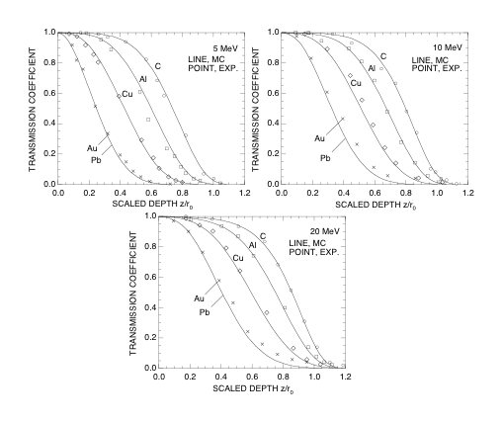
Results
Transmission curves: Normal incidence
  MC results compared with experimental data
Experiment: Harder and Poschet, Phys. Lett. 24B,
519 (1967); insensitive to secondary electrons only when incident on the detector with the primary
Notes:
Now we show the results obtained.
In this viewgraph, some of Monte Carlo results for the transmission curve are compared with experimental data. The horizontal axis represents the scaled depth, namely the depth in units of the CSDA range r0 of the incident electrons.
The experimental data have been taken from the paper by Harder and Poschet.These authors used a scintillation counter as the detector for the transmitted electrons to minimize the effect of knock-on electrons. Thus the definition of the transmission coefficient in their experiment is consistent with the present calculations so far as a knock-on electron is incident together with its parent primary electron to give a single count.
However, a secondary electron generated by a bremsstrahlung photon can reach the detector even after the parent primary electron has been absorbed. This seems to be the cause of small difference between the present Monte Carlo results and experiment at large depths for higher energy electrons incident on the highest atomic number absorbers.

Slide 9
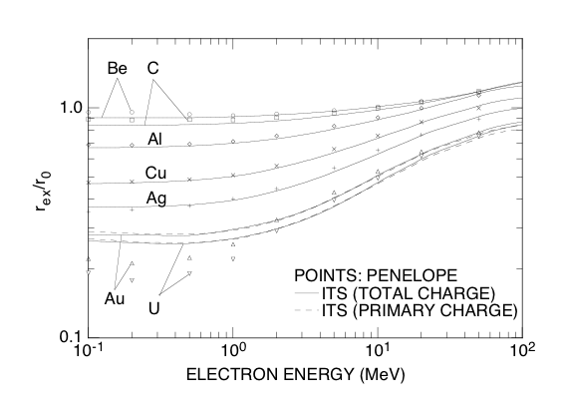
Transmission curves: Normal incidence (continued)
  r_{ex}: Comparison with r_{ex} from charge-deposition distributions in semi-infinite medium
Appreciable differences: only for low energy electrons incident on the highest Z absorbers.
Notes:
The extrapolated ranges determined from the transmission curves of PENELOPE (points) are compared in this graph with those determined from the total charge deposition distributions, which in turn were calculated by the ITS Monte Carlo system (solid lines). Here “total” means primary plus knock-on electrons.
The two sets of results differ in the geometrical condition; for the PENELOPE results, it is finite slab absorbers, and for the ITS results, it is semi-infinite absorbers. Previously it was found from experimental results by myself and coworkers that this difference in geometry did not appreciably affect the values of the extrapolated range at least in the energy region above about 5 MeV. The present comparison between the two Monte Carlo results confirms this, except for the electrons of energies up to 1 MeV incident on the absorbers of the highest atomic numbers.
To check the effect of the different treatment of knock-on electrons, which are counted in the ITS cgarge distributions but not in PENELOPE transmission curves, we have shown here another set of rex for highest Z absorbers determined from primary charge deposition distributions or range straggling distributions (dashed lines). The solid and dashed line results agree well, and therefore, the effect of the different treatment of knock-on electrons can be excluded from possible reasons for the differences between the PENELOPE and the ITS results.

Slide 10
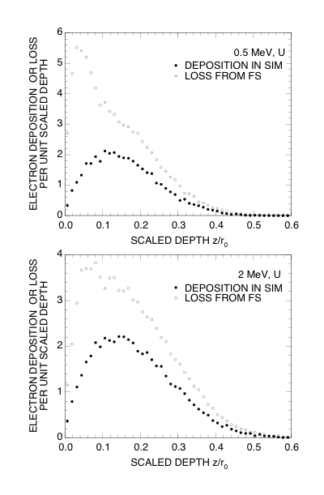
Transmission curves: Normal incidence (continued)
  The reason for the differences in r_{ex}
Notes:
(Previous OHP) Then, can we say that the differences have been caused by the differences in the geometry? No, we cannot. The absence of the backscattering from larger depths in the finite slab geometry, if it has any effect, would make the extrapolated range larger than in the semi-infinite medium, but the differences observed are in the opposite direction.
What can then be the reason for those differences?
(OHP No. 10) We can notice the reason by comparing the differential transmission curve with the range straggling distribution. In these graphs both types of curves are the results of the PENELOPE code. The differential transmission curve(open circles) shows the differential loss of electron number and include the loss of primary electrons by backscattering from the incident surface. On the other hand, such a loss does not directly affect the range straggling distribution (closed circles) but only reduces the area under the distribution curve. Therefore, when the extent of backscattering from the incident surface is extremely large, the absorption peak, which is essentially the same as the range straggling distribution, is piled up with the backscattering loss, as can be seen in the upper graph of 0.5-MeV electrons incident on U, to modify the range straggling distribution heavily, thus yielding a different extrapolated range.

Slide 11
Transmission curves: Normal incidence (continued)
  Analytic expression for r_{ex}/r₀
The same functional form as used by Tabata et al.,
[NIM B 119, 463 (1996)] for fitting r_{ex}/r₀ from
charge-deposition distributions.
Notes:
(Previous OHP) For 2-MeV electrons incident on U shown by the the lower graph, however, the modification of the peak is such that the changes in values of the two terms in the equation to determine rex, as shown at the bottom of this viewgraph, are compensated for. In the equation here xm and ymrepresent the coordinates of the peak position of the differential transmission or range straggling curve, and A is the area under the curve from xm to infinity. The compensation is guaranteed by a rather flat top of these curves.
(OHP No. 11) Using the extrapolated ranges obtained from the transmission curves, we have formulated an analytic expression for the ratio rex/r0 as shown in this viewgraph.
The functional form used is the same as the one used by myself and coworkers in 1996 for fitting the same ratio obtained from charge deposition distributions.

Slide 12
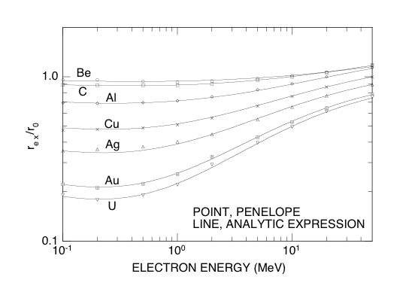
Transmission curves: Normal incidence (continued)
  Analytic expression for r_{ex}/r₀ (cont.)
Notes:
This graph compares the analytic expression obtained with the PENELOPE Monte Carlo results. The expression is seen to have been well fitted to the Monte Carlo results.

Slide 13
Transmission curves: Normal incidence (continued)
  Empirical formula for η_{TN}
    Rao type [Rao, NIM 44, 155 (1966)]
    Ebert type [Ebert, Lauzon & Lent, Phys. Rev. 183, 422 (1969)]
    The average of weighted rms relative deviations of fits to a total of 63 transmission curves
      Rao Type: 3.4%
      Ebert type: 2.4%; adopted
Notes:
As I told you in introductory part, two types of functions have been proposed in the literature to express the transmission curve.
One was proposed by Rao in 1966, and is given by the upper equation.
The other was proposed by Ebert and coworkers in 1969, and is given by the lower equation. Though the use of extrapolated range in the form of the lower equation was first made by them, almost all the earlier empirical equations for the transmission curve had the functional form equivalent to this.
We have compared the averages of weighted rms relative deviations of fits to a total of 63 transmission curves for the two types of functions, and have found that Ebert type shows better fits.
Thus we have adopted the Ebert type function for our empirical formula. On the other hand, Rao type was found to be better in our comparison made with experimental data collected from the literature in 1975. In both of the comparisons, the difference in the average of deviations is rather small, and the type of function discarded is not considered so bad.

Slide 14
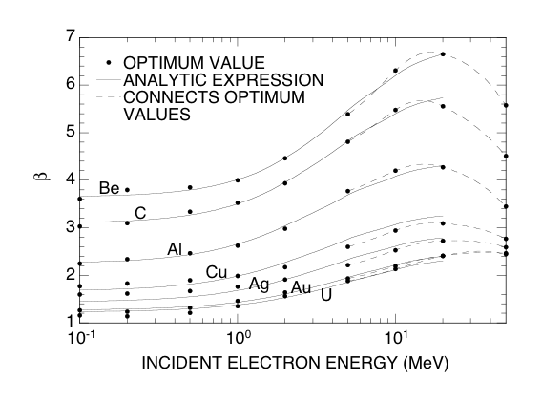
Transmission curves: Normal incidence (continued)
  Empirical formula for η_{TN} (cont.)
    Coefficient β: values and expression
The coefficient β takes on a maximum at an energy 15–30 MeV.
To avoid complication of the functional form, we have considered an expression applicable up to 20 MeV.
Notes:
The next thing we have to do for obtaining a general empirical formula for the transmission curve is to formulate an analytic expression for the adjustable coefficient beta in the Ebert-type function.
As can be seen from the dashed lines that connects the optimum values of beta in this graph, beta has been found to take on a maximum value at an energy from 15 to 30 MeV depending on material,.
To avoid complication of the functional form, we have considered an expression applicable up to 20 MeV.
Solid lines in this graph show the expression we obtained.
The expression itself is given in the next viewgraph.

Slide 15
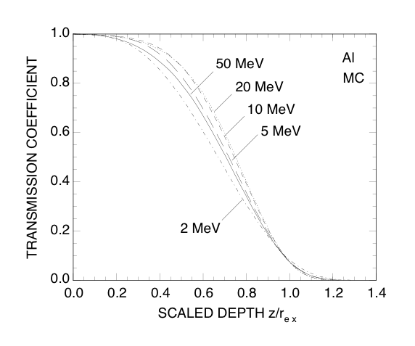
Transmission curves: Normal incidence (continued)
  Empirical formula for η_{TN} (cont.)
    Analytic expression for β
    Why does β become smaller again at high energies?
Notes:
Here the first equation expresses the dependence of beta on incident electron energy, and coefficients from b1 to b4 are functions of the atomic number of the absorber, which are given by the next four equations.
To see the reason why beta becomes smaller again at high energies, we have plotted here transmission curves for Al at different energies as a function of depth in units of extrapolated range instead of CSDA range.
Even in this plot, the initial decrease of the transmission curve is slower for higher energies up to 20 MeV in the case of Al absorbers shown here, and this is reflected by the larger values of beta at higher energies.
However, the decrease of the transmission coefficient with increasing depth is again faster at 50 MeV, as can be seen from the solid line in this graph. This is reflected by a smaller value of beta.This trend is considered to be caused by the fact that the increasing effect of radiative energy loss with increasing energy on the number transmission coefficient outweighs the decreasing effect of multiple-scattering detours.

Slide 16
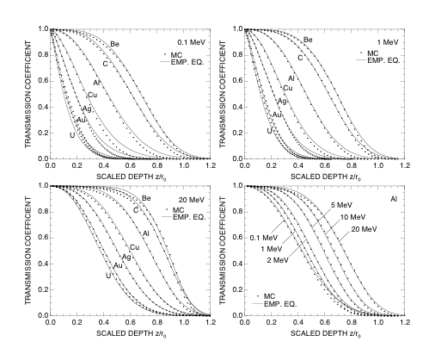
Transmission curves: Normal incidence (continued)
  Empirical formula for η_{TN} (cont.)
    Comparison with MC results
Some systematic deviations indicate that the
functional form is not flexible enough,
but the formula is moderately good as a whole.
Notes:
The empirical formula obtained for the transmission curve at normal incidence is compared with the PENELOPE Monte Carlo results in these graphs.
There are some systematic deviations, especially at the lowest energies, indicating that the functional form is not flexible enough to fit all the different transmission curves.
However, the formula is seen to be moderately good as a whole.

Slide 17
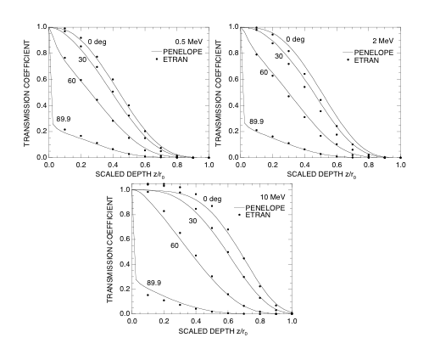
Transmission curves: Dependence on angle of incidence, θ
  Comparison of PENELOPE results with previous data:
Watts & Burrell (1971) by ETRAN,
Knock-on electrons included
Notes:
Now we show the results for the dependence of the transmission curve on the angle of incidence, theta.
In this viewgraph, PENELOPE results are compared with the previous Monte Carlo results reported by Watts and Burrell in 1971. They used the ETRAN code to obtain the transmission curves for 0.5 to 10 MeV electrons incident on Al.
The ETRAN results counted knock-on electrons as the transmitted electron. So for the 10-MeV electrons incident at the angles of 0 and 30 deg, the transmission coefficient once becomes larger than unity by about 5% at small depths, and then decreases with increasing depth.
Except for such an effect due to knock-on electrons, the PENELOPE results agree rather well with the ETRAN results.

Slide 18
Transmission curves: Dependence on θ (continued)
  Empirical Formula
    Extension to include the dependence on θ
Notes:
We have extended our empirical formula for the transmission coefficient to include the dependence on the angle of incidence, theta.
This has been done by incorporating the dependence on theta into the expressions for both the extrapolated range and beta in the form given by these equations.
We do not show the expressions for c1 and c2, because the result is yet tentative, and we are going to study further improvements of the expressions.

Slide 19
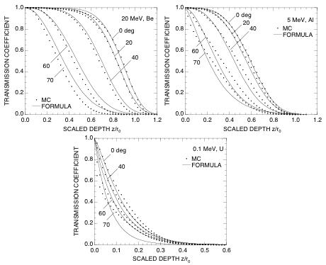
Transmission curves: Dependence on θ (continued)
  Empirical Formula (cont.)
    Comparison with MC results
Larger errors at larger angles
Tolerable errors up to 30 or 40 deg
Notes:
Some examples of transmission curves given by the extended empirical formula are compared with the Monte Carlo results in these graphs.
The formula is good for the angles of incidence up to 30 or 40 deg, but its error is rather large at larger angles.
It might be necessary to reconsider the use of the Rao-type function we discarded, as will be suggested by the comparison of the average depths of electron penetration in Vadim's talk.

Slide 20
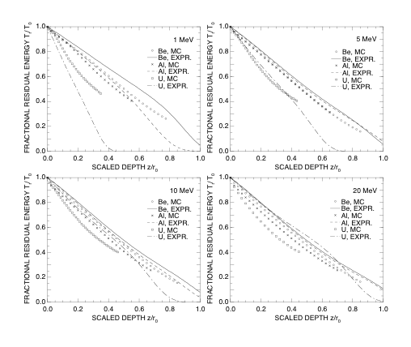
Residual energy: Normal incidence
  PENELOPE results
    Comparison with an approximate expression [used in the depth–dose algorithm by Tabata et al., Radiat. Phys. Chem. 53, 205 (1998)]
Notes:
Finally we show the results for the residual energy of transmitted electrons.
The ratio of the residual energy to the incident energy, namely the fractional residual energy, is plotted as a function of scaled depth for different incident energies and absorber materials in these graphs. Points represent the Monte Carlo results and lines represent an approximate expression used in a depth-dose algorithm mpublished last year by myself and coworkers.
The Monte Carlo results at large depths are not shown because of large fluctuations due to insufficient statistics and an artifact caused by the cutoff energy, which have not been small enough for obtaining residual energies at large depths.
The approximate expression is not the direct fit to the data on the residual energy, so that we do not expect its good agreement with the Monte Carlo results. In fact, the expression does not give accurate estimates of the residual energy except around the energy of 5 MeV. However, the functional form of the expression is considered to serve as the starting point for making a new empirical formula.

Slide 21
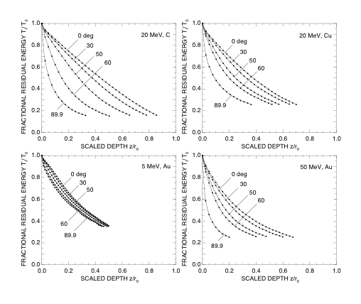
Residual energy: At different angles of incidence
  PENELOPE results
Notes:
The residual energy as a function of depth is shown for different angles of incidence in the cases of representative combinations of incident energies and absorber materials in these graphs.
The upper two graphs compare the curves between different absorber materials of C and Cu at the same energy of 20 MeV. The lower two graphs compare the curves between different incident energies of 5 and 50 MeV for the same absorber material of Au.
It is seen that the differences among the curves for different angles are smaller for higher atomic number absorbers and for lower incident energies.

Slide 22
Concluding Remarks
Comprehensive data sets on η_{TN} and T_{r} have been generated by PENELOPE according to the strict definitions of these parameters.
Interesting trends have been found for η_{TN} and r_{ex}.
A general empirical formula for η_{TN}, which includes the dependence on θ, has been obtained.
A similar formula for T_{r} is going to be studied.
Notes:
In the present work, we have generated by the PENELOPE Monte Carlo code comprehensive data sets on the transmission coefficient of electrons and the residual energy of transmitted electrons according to the strict definitions of these parameters.
Interesting trends have been found for the transmission curves and extrapolated ranges derived from these curves.
On the basis of the Monte Carlo results, we obtained a general empirical formula for the transmission coefficient, which includes the dependence on the angle of incidence, though further improvements should yet to be studied.
We are also going to study a similar empirical formula for the residual energy of transmitted electrons.
Thank you for your attention.

